Slide 1

Wisconsin breast cancer tumor prediction
Prof. sadeghi
By Mohammad Dehghan-Rouzi(810197243)
dehghanr.mohammad@gmail.com
dehghanr.mohammad@ut.ac.ir

Slide 2
Classifiers
1. Random forest
2. Naïve Bayes
3. MLP
4. SVM
5. Logistic regression
6. K-Nearest neighbor
7. Linear regression

Slide 3
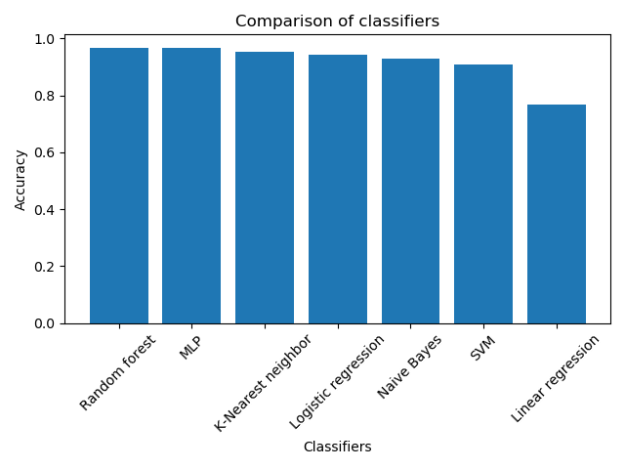
Results
Random forest and MLP
Accuracy: 0.965

Slide 4
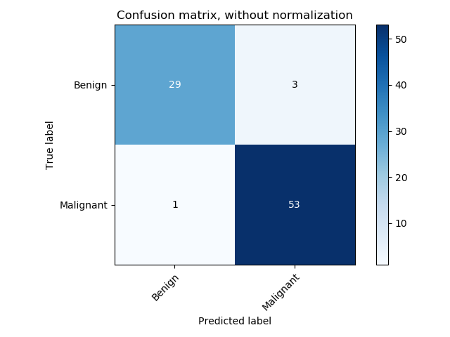
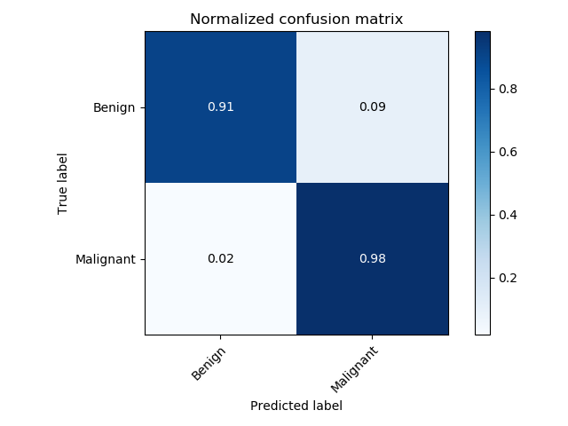
Confusion matrix for MLP
f

Slide 5
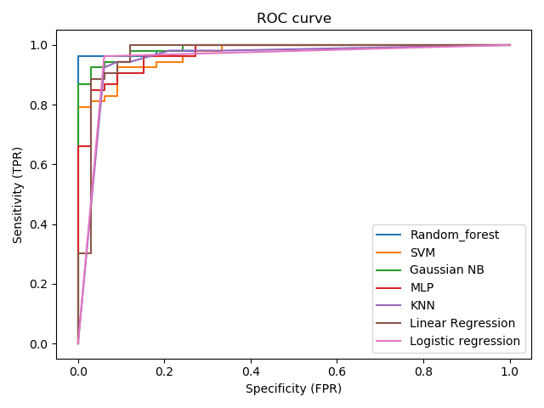
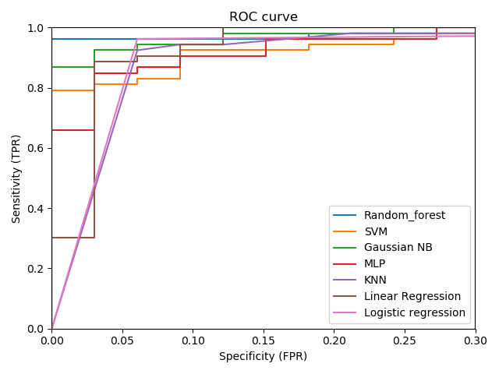
ROC Curve

Slide 6


